Slide 1

COLLEGE CREDIT IN TEXAS HIGH SCHOOLS
Kevin Clark, Poonam Goel, Kimberly Reeves, Rebekah Rowland

Slide 2
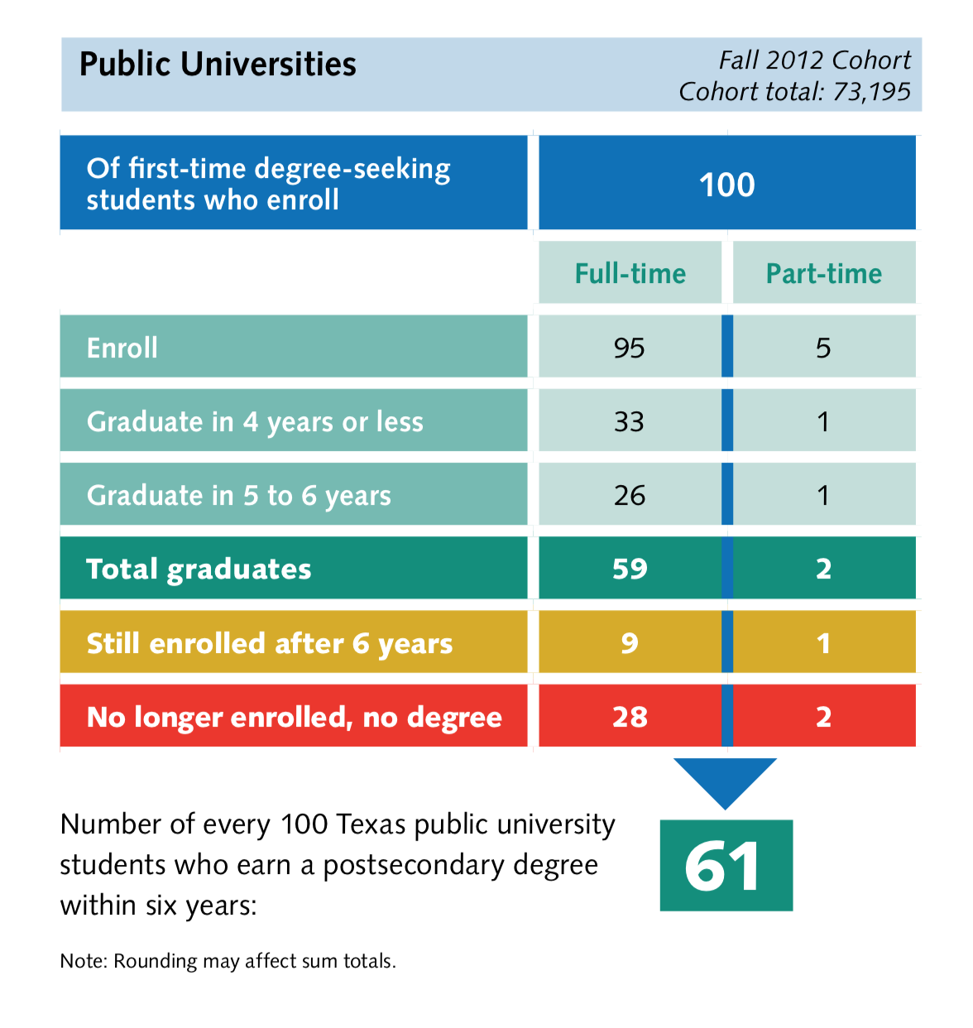
TEXAS UNIVERSITIES
More than 70,000 students enroll in Texas universities each year, but only 1 in 3 will graduate in 4 years or less.
The average level of debt for the Class of 2018 was $30, 825.
Last year,185,222 high school students took some kind of course – dual-credit, AP, IB and now CTE dual-credit – that would earn them college credit.
- 2019 Almanac, Texas Higher Education Coordinating Board

Slide 3
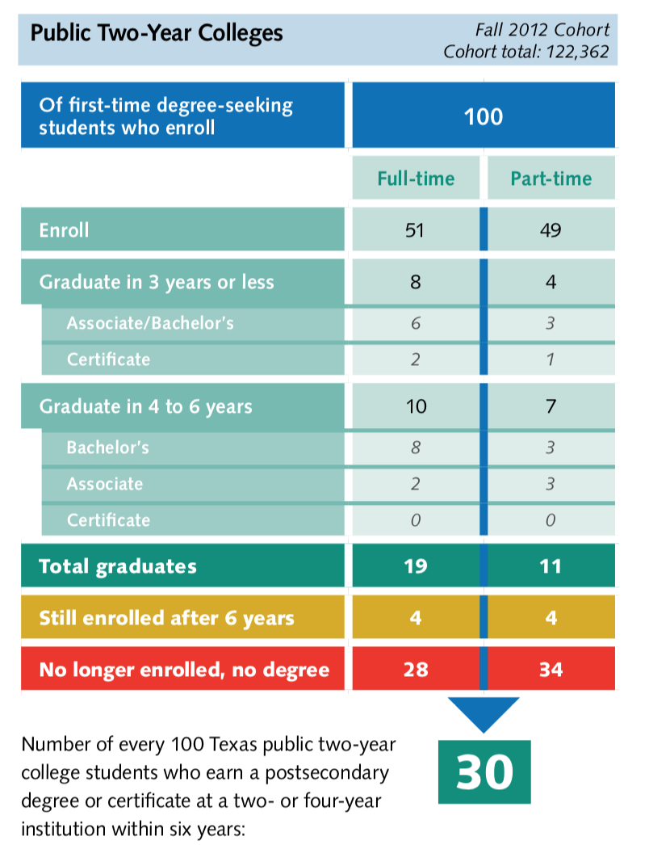
TEXAS COMMUNITY COLLEGES
Almost twice as many students – 122,362 --will enroll in 2-year Texas community colleges. Students are almost equally divided between full time and part time.
The graduation rate for 4-year universities, ultimately, is 61 percent. For community colleges, that number drops to 30 percent.
The state now offers more opportunities than ever for students seeking a certificate to get college credit before graduation.
- 2019 Almanac, Texas Higher Education Coordinating Board

Slide 4


Slide 5

OUR QUESTIONS
What is the year-over-year counts of students – both CTE and all students -- enrolled in college credit courses, 2014-2018?
What is the count of total college course offerings each school year, between 2014-15 and 2017-18? What are the general trends in the types of courses offered?
What is the breakdown in the general types of college credit offerings, by subject area?
Do CTE students, on average, earn as many college credits as their peers?

Slide 6
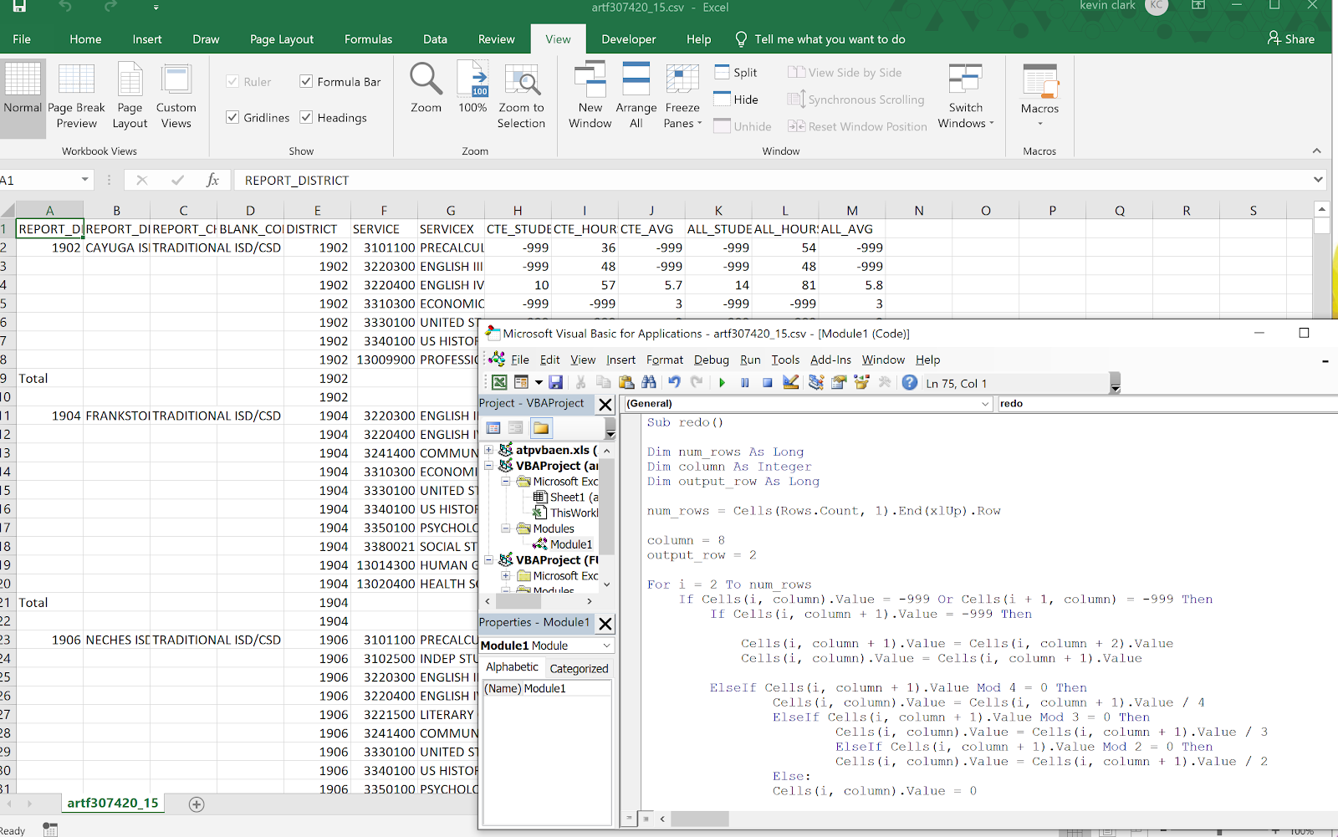
DATA CLEANUP & EXPLORATION
CSV files of ISD college course offerings for each of 4 years :
Files had “*” which represented values of fewer than 5. It could be located in any, or multiple columns. When converting csv to Excel, these changed to -999. To account for this anomaly, we used a macro programmed through Visual Basic Studio to estimate the values of the “*, based on the value in other columns.

Slide 7
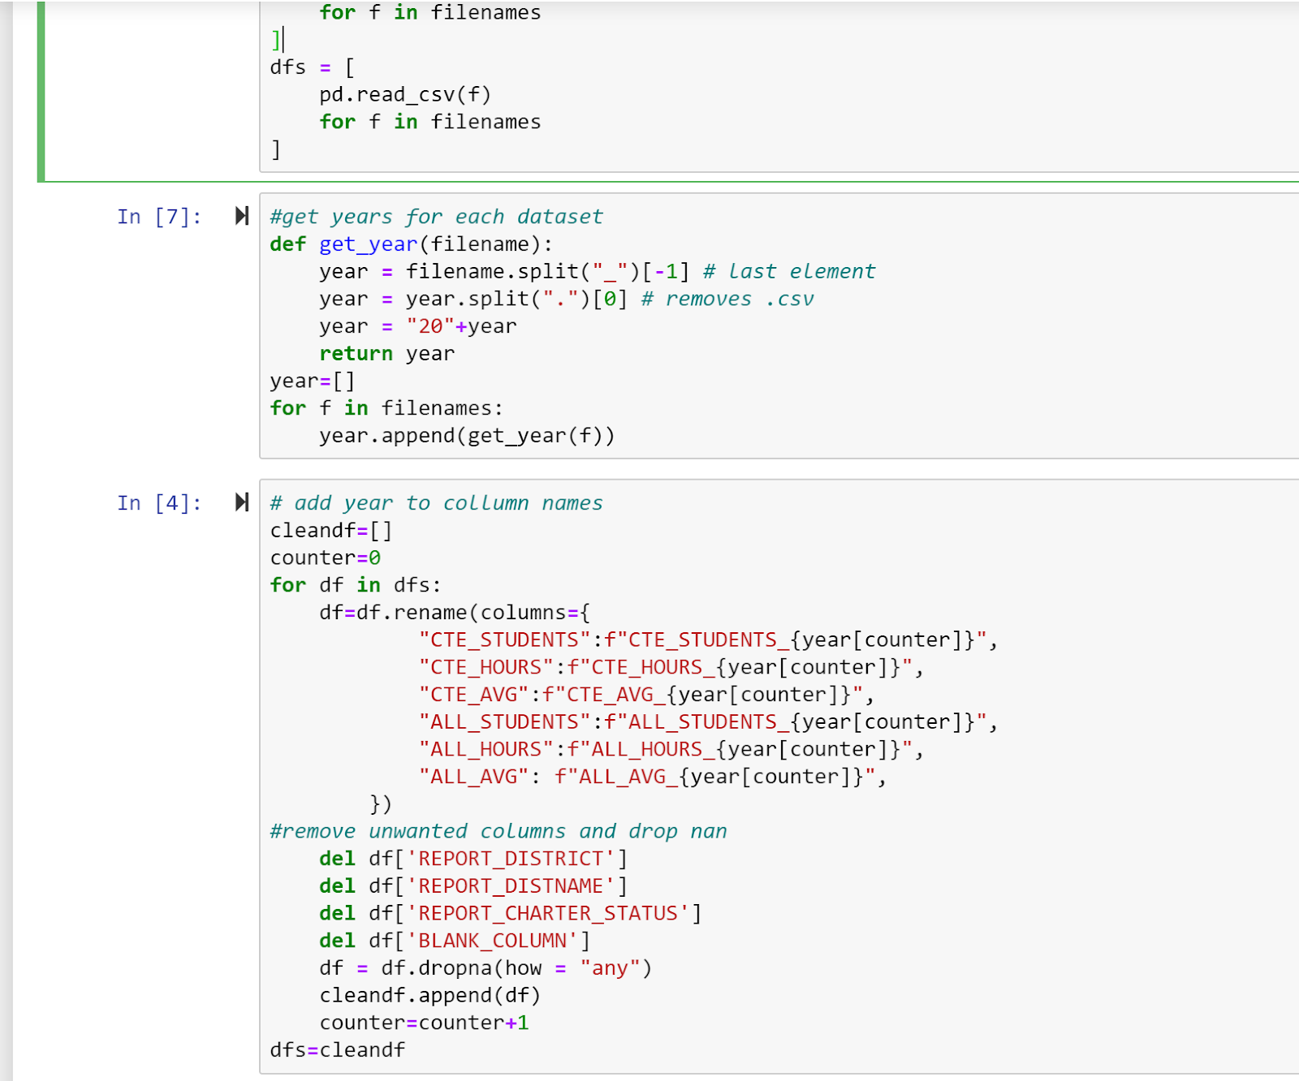
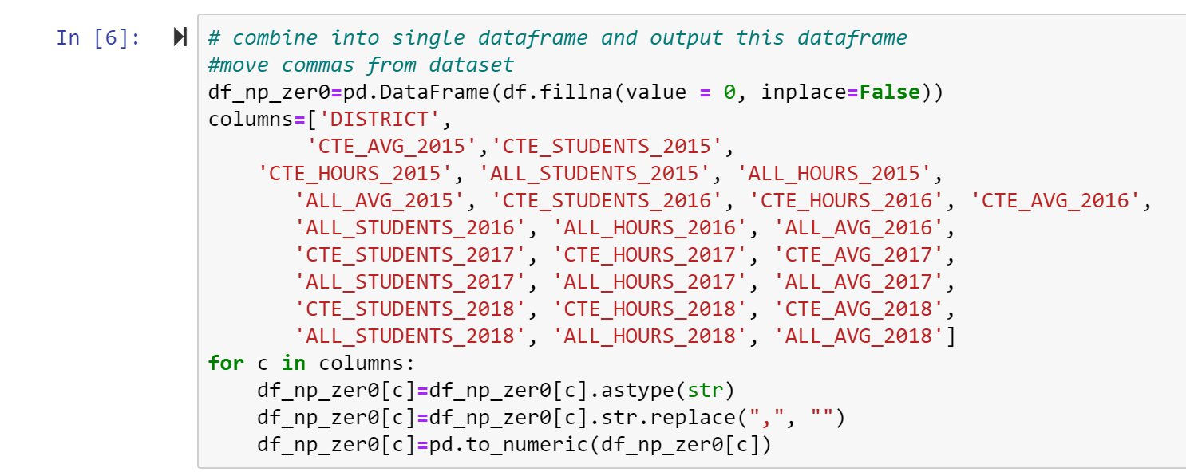
DATA CLEANUP & EXPLORATION
Once the Excel sheets contained the correct data, we created a set of Pandas DataFrames containing the 4 sets of data. We adjusted the following for each csv file:
Add year to all columns headers within each spreadsheet.
The code also drops all non-essential miscellaneous columns used
Rename columns to uniform name and add year
Removed any remaining -999 and changed all data to numeric values
Merge into single data set based on District and Course number

Slide 8
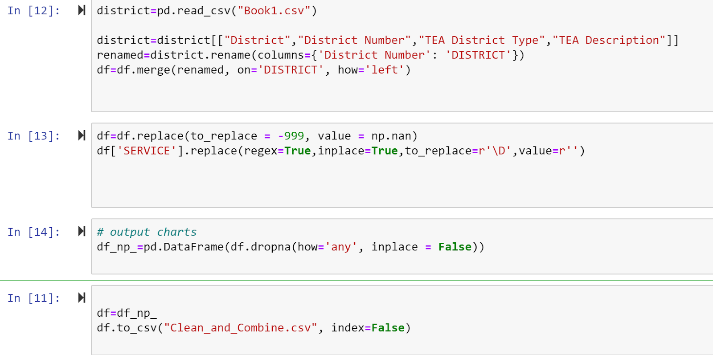
DATA CLEANUP & EXPLORATION
After merging the datafiles, we recognized we wanted to sort our college credits by the size and type of school district.
We located and read in a csv file on the Texas Education Agency website that identified school districts by type: fast-growing, major urban, suburban, rural, etc.
The column containing district numbers was renamed to match the other data set so that merge function could be used.
This final dataset was written to a csv file the team to use as needed for our analysis.
Overall, we went from 19,974 lines of class data prior to drops and came out with 19,842 We only dropped only .6 percent of our data.

Slide 9
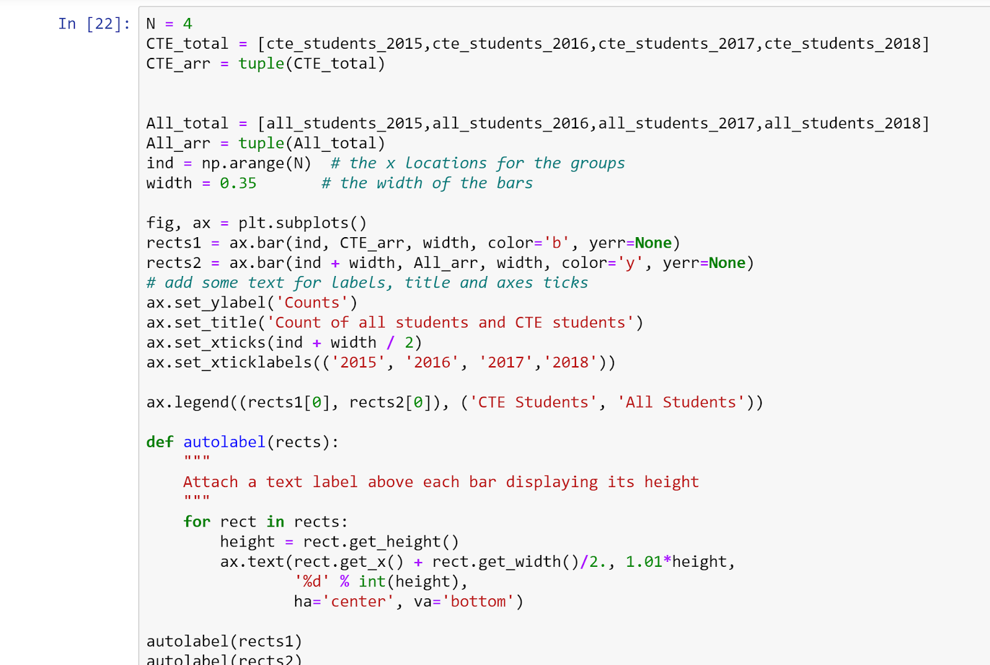
DATA READY FOR ANALYSIS
Imported the cleaned up CSV data into a Pandas Data Frame.
Calculated the sums of students enrolled in college-credit courses -- CTE and all students -- across all districts over the years 2015 through 2018.

Slide 10
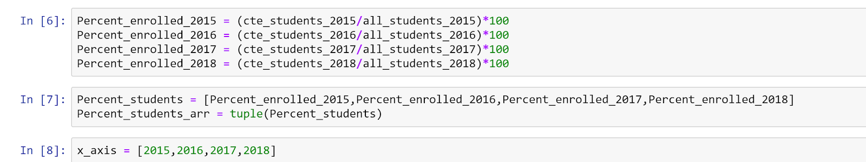
CALCULATION: PERCENTAGE GROWTH IN ENROLLMENT

Slide 11
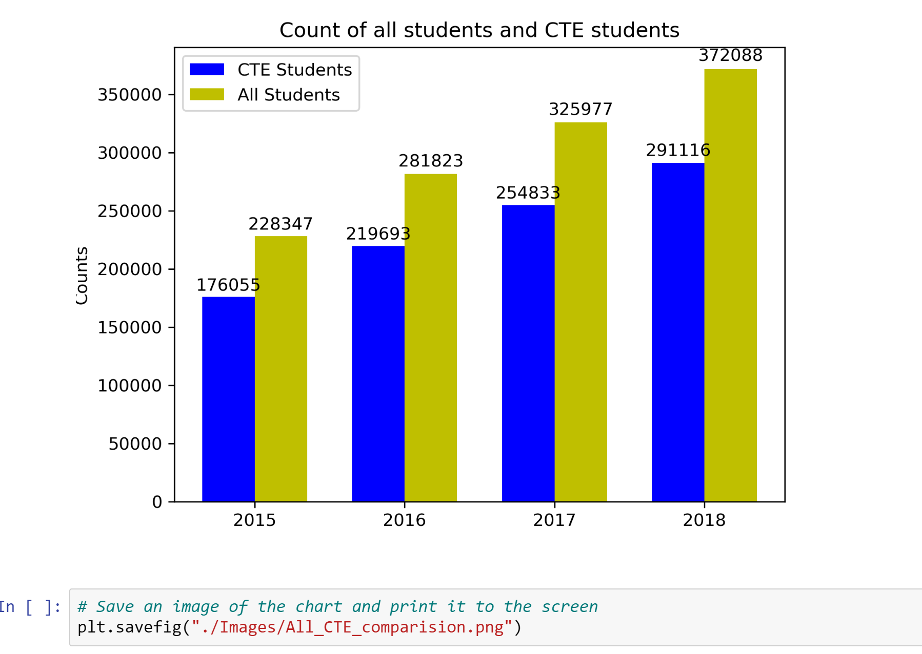
Percentage Growth in Enrollment in College Credit Courses

Slide 12

CALCULATE PERCENTAGE OF CTE STUDENTS TAKING CLASSES

Slide 13
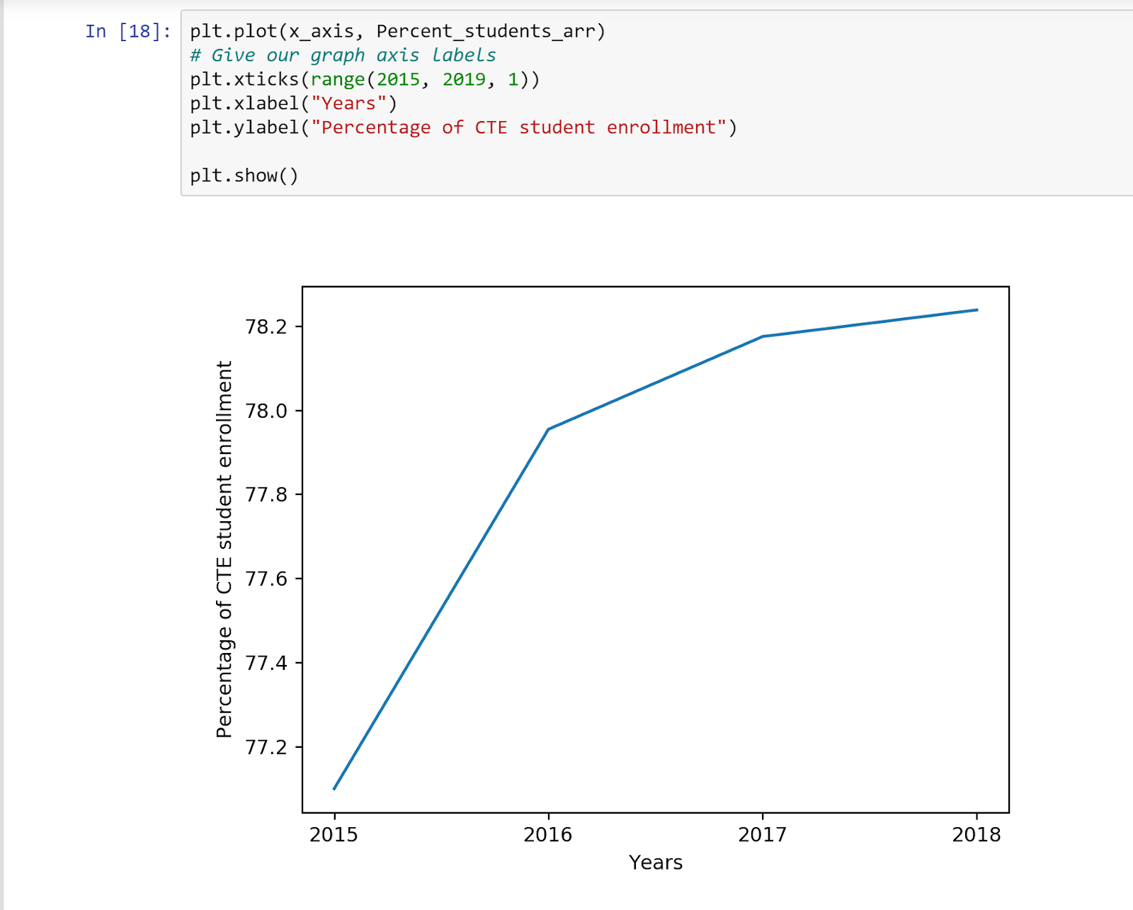
% CTE STUDENTS TAKING COLLEGE CREDIT CLASSES

Slide 14

DATA ANALYSIS: COURSE OFFERINGS BY MAJOR SUBJECT AREA
CTE/Tech
Medical Terminology, Welding, Business Management, Cosmetology
Social Sciences
Economics, Psychology, Art Appreciation
English
Communication Applications, Public Speaking,
STEM
Precalculus, Biology, Physics
Miscellaneous
Aerobic Activities, Student Leadership

Slide 15
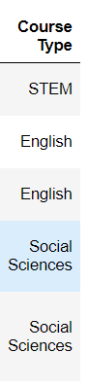
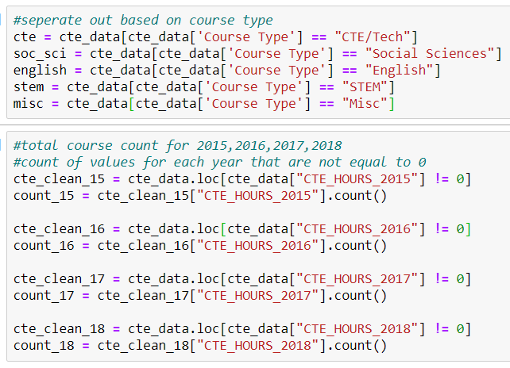
We created bins based on course number which gave us a new column: “Course Type”
Created new dataframes based on each course to be referenced later
Calculated the total number of courses for each year. (Had to seperate values out to values that did not equal 0)
SORT AND CALCULATE %
OF COLLEGE CREDIT COURSES BY SUBJECT

Slide 16
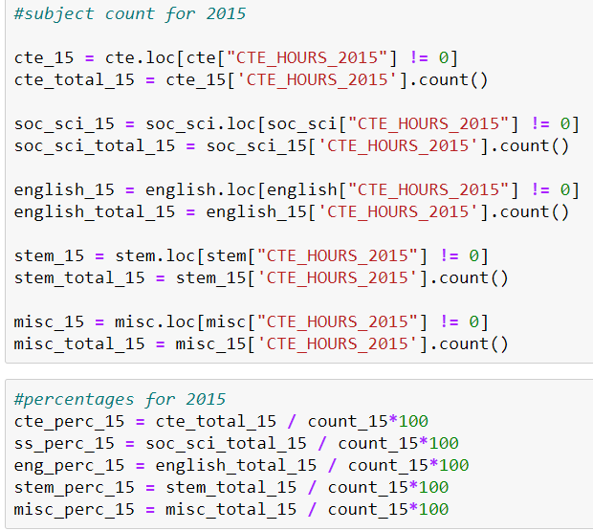
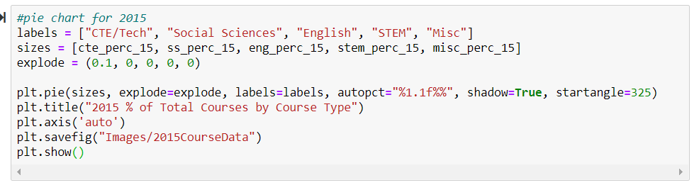
Then, I needed the count of each subject for the specific year.
Finally, I was able to calculate a percentage by taking the sum of each course and dividing by the total course count
Using that information, I created a pie chart for each year.

Slide 17
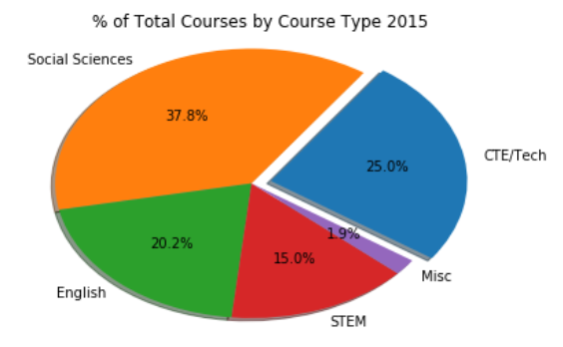
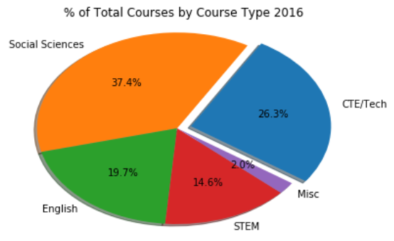
COURSE OFFERINGS 2015 VS. 2016

Slide 18
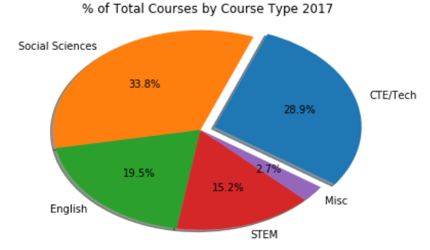
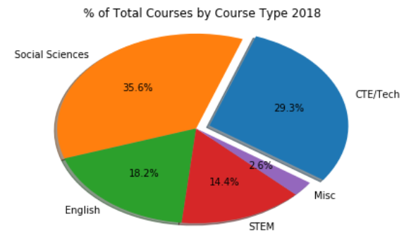
COURSE OFFERINGS 2017 VS. 2018

Slide 19
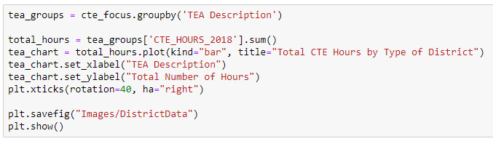
DATA ANALYSIS BY DISTRICT TYPE:
9 Types of School Districts: based on factors such as enrollment, population size, and proximity to urban areas.
Utilized our bins for course types from earlier.
Grouped by TEA Description to get our X-Axis
Used the sum function to find the total number of hours for CTE in 2018.

Slide 20
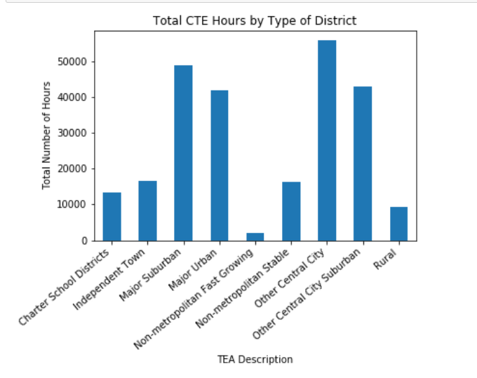
Districts with the highest number of CTE hours:
Other Central City
Major Suburban
Other Central City Suburban
Major Urban

Slide 21
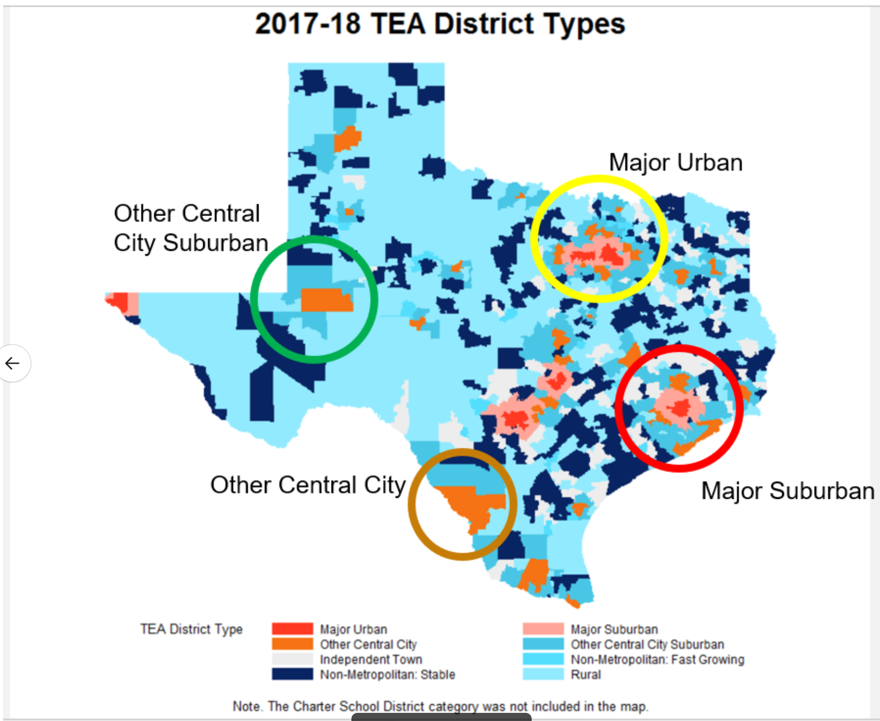
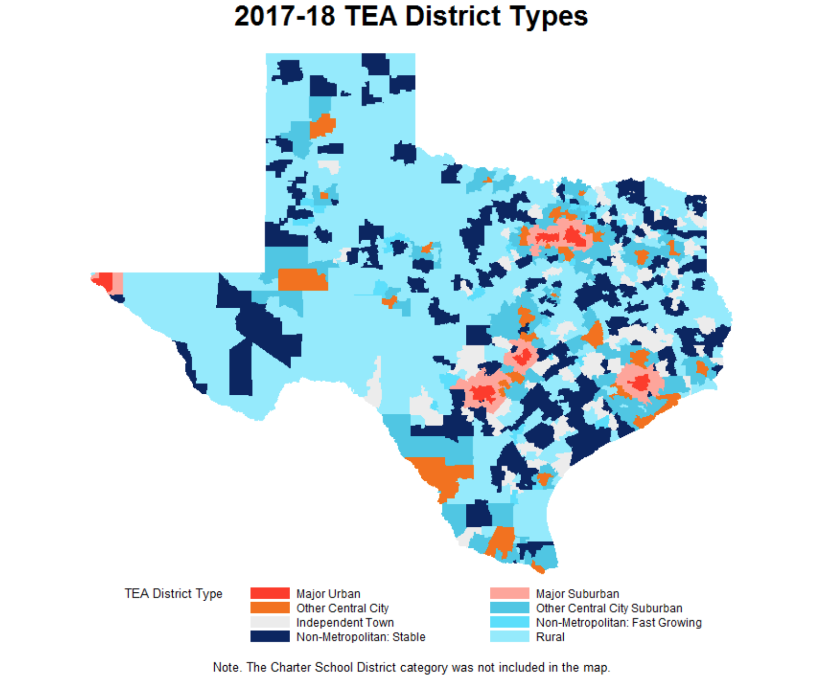

Slide 22

CONCLUSIONS
Enrollment in college credit courses for all students has increased every school year since 2014-15, but it has increased even more significantly for CTE students.
However, we still see a higher number of students participating in traditional dual credit courses.
Students pursuing college credits in English have been decreasing.
The bill passed in 2015 had an exponential effect CTE enrollment.

Slide 23
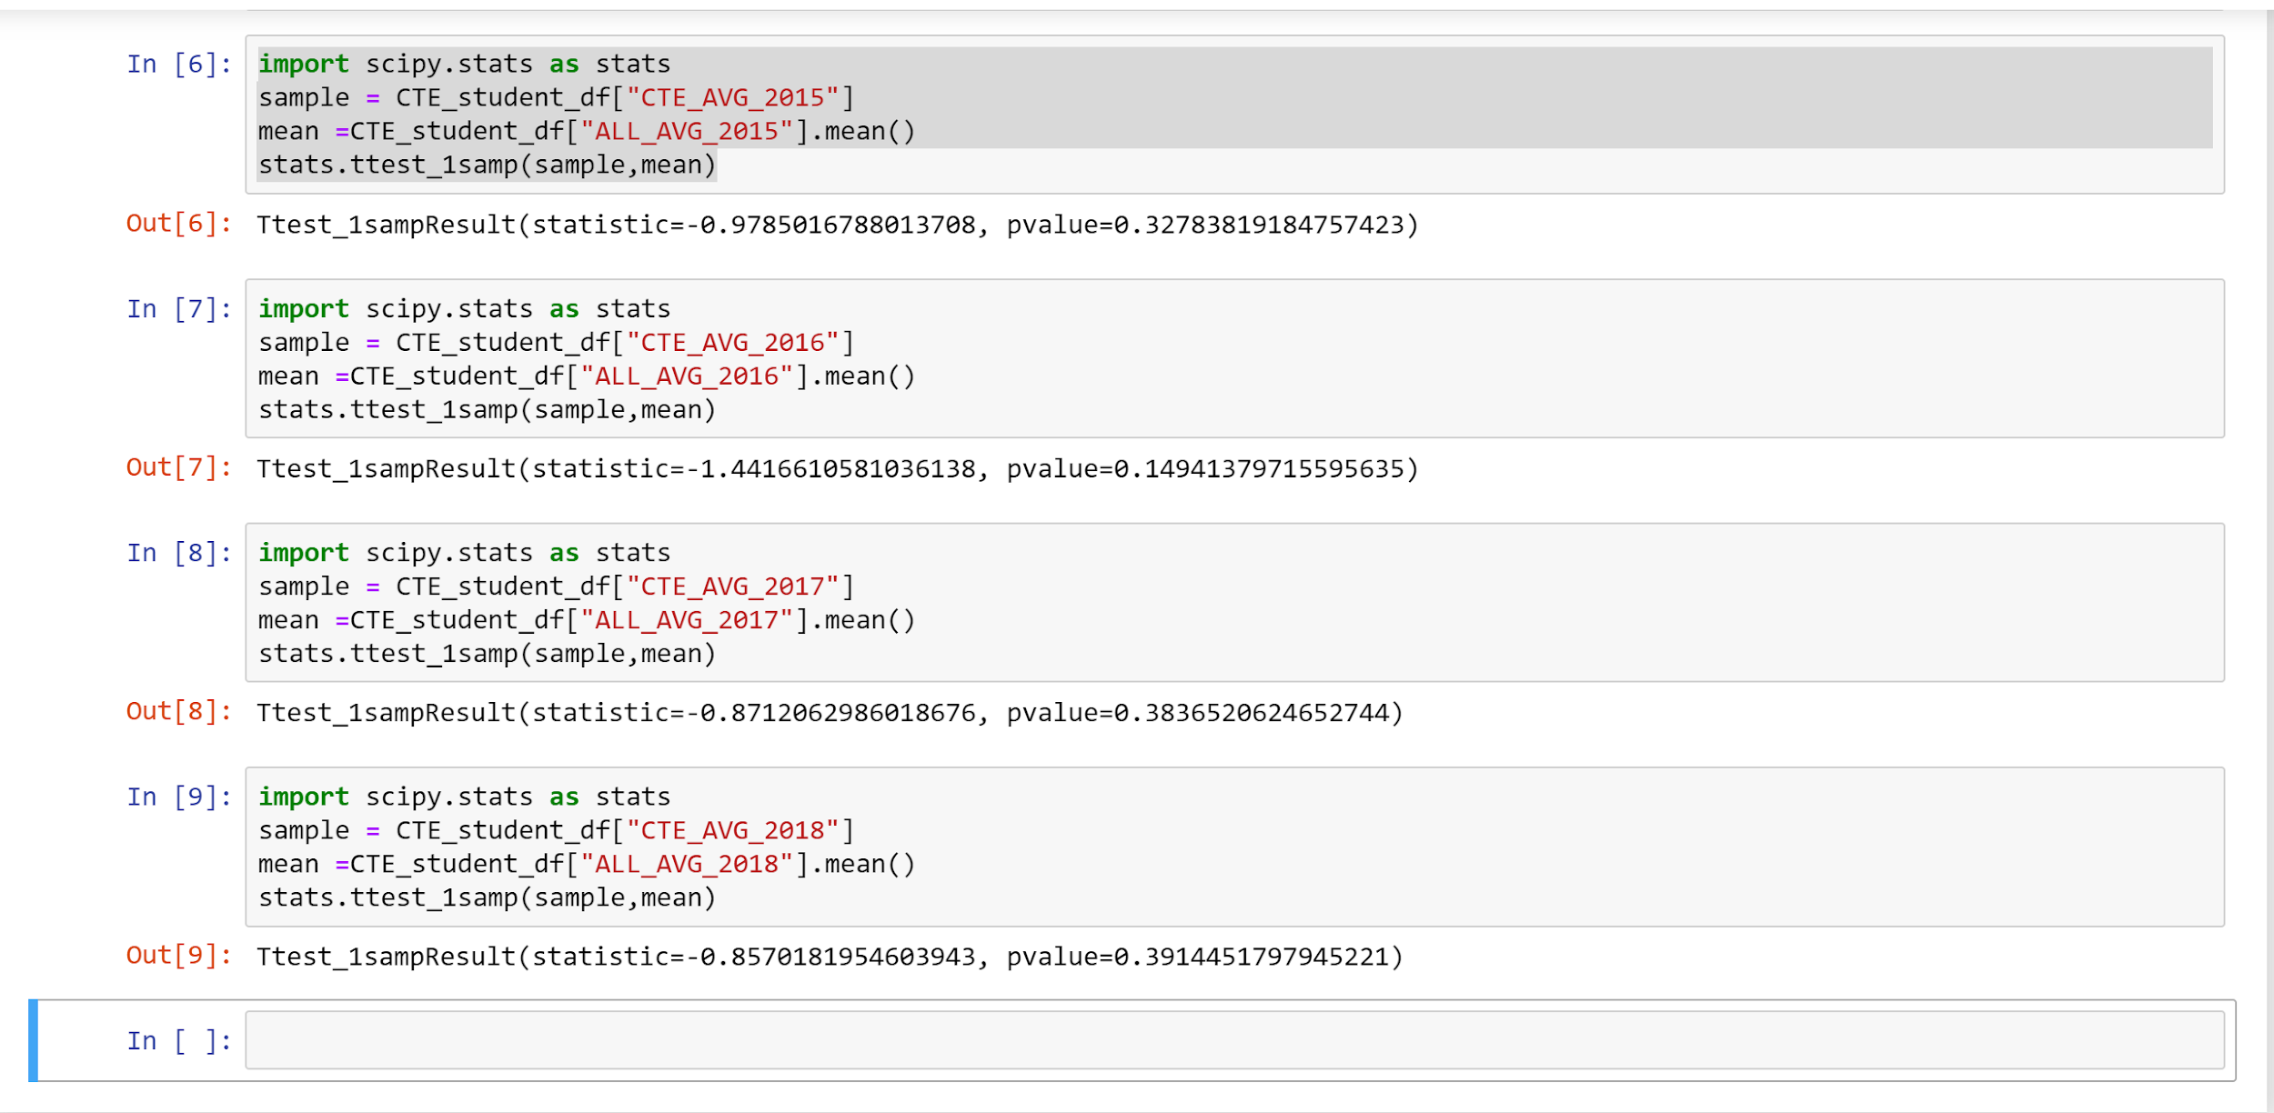
T-TEST PART 1:
Notes:
T-test shows that there not a significant difference in the CTE enrolled students and students as a whole.

Slide 24
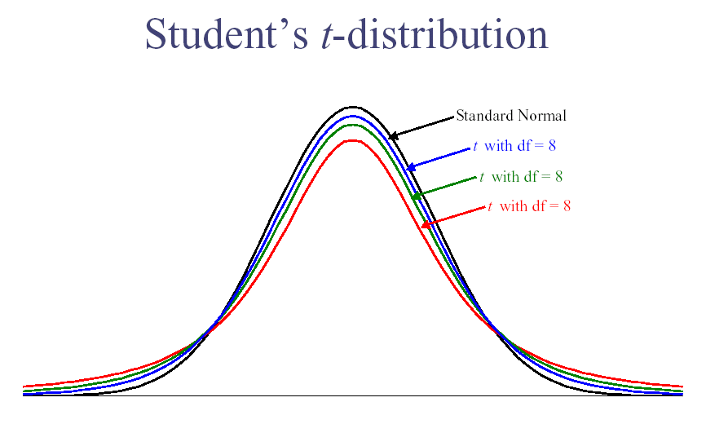
Notes:
The t-distribution, used for the t-test. Image: Carnegie Mellon. The t test tells you how significant the differences between groups are; In other words it lets you know if those differences (measured in means/averages) could have happened by chance.

Slide 25
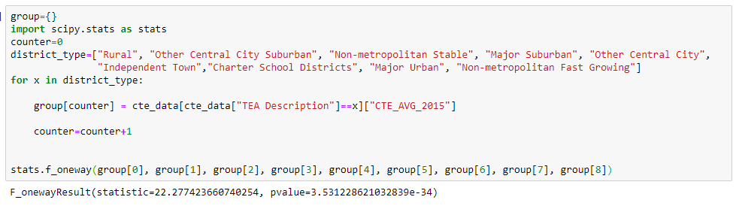
T-TESTS PART 2:

Slide 26
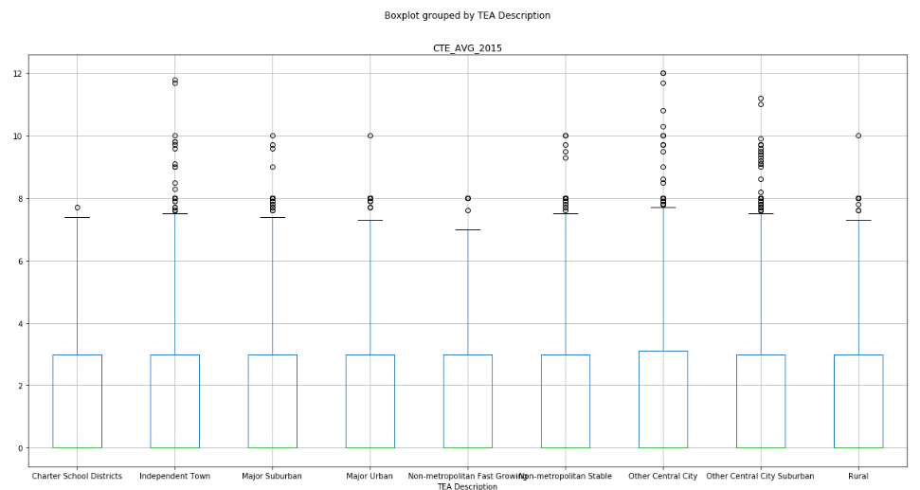

Slide 27
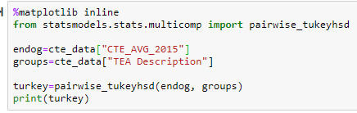
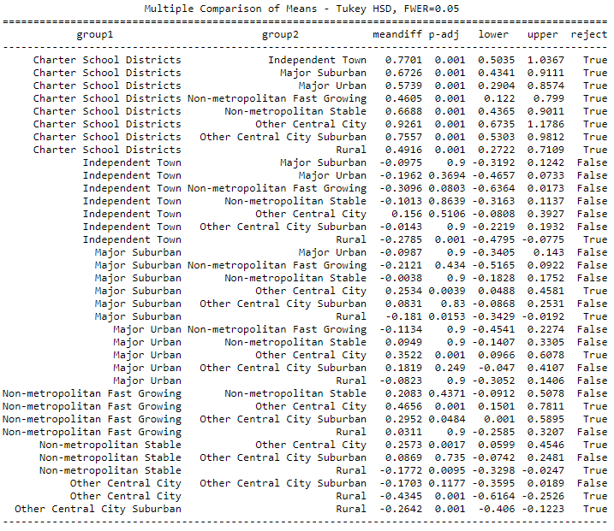

Slide 28
What we learned:
“I learned the importance of DRY vs. WET coding. I took the approach of WET coding (Write Everything Twice) and it took me much longer than anticipating. Afterwards, I was able to see opportunities where I could have been DRY (Don’t Repeat Yourself)” - Rebekah
“Once we decided on the datasets to research, we brainstormed and wrote down our thought process and listed and relisted the graphs we would be making to present our analysis. It helped me also a lot reading about the bill that was passed in 2015 on the TEA website and was very happy when I came across research and findings that had already been published reiterating our analysis” - Poonam
“I learned that sometimes is easier to use what you know instead of trying to reinvent the wheel. There are many different ways to accomplish a goal in programing and sometimes it is best to stick with what you know in order to keep yourself from getting lost in your own code.” -Kevin
“TEA collects data in ways that are very siloed. To come to any real quantitative conclusions, you have to combine multiple data sets.” - Kimberly

Slide 29
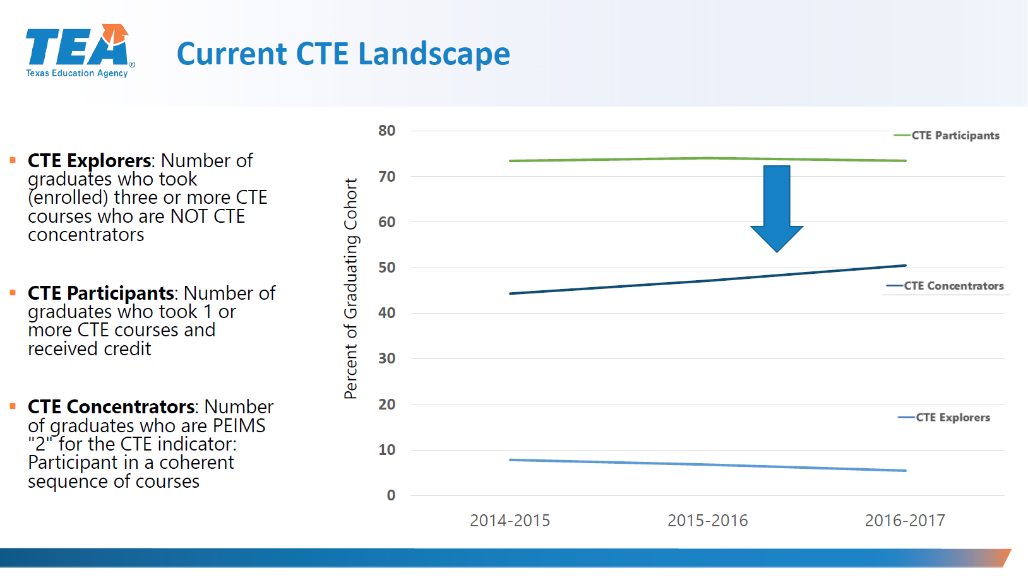
Notes:
Current analysis published by TEA supports our analysis of data that shows the growth of CTE participants.

Slide 30
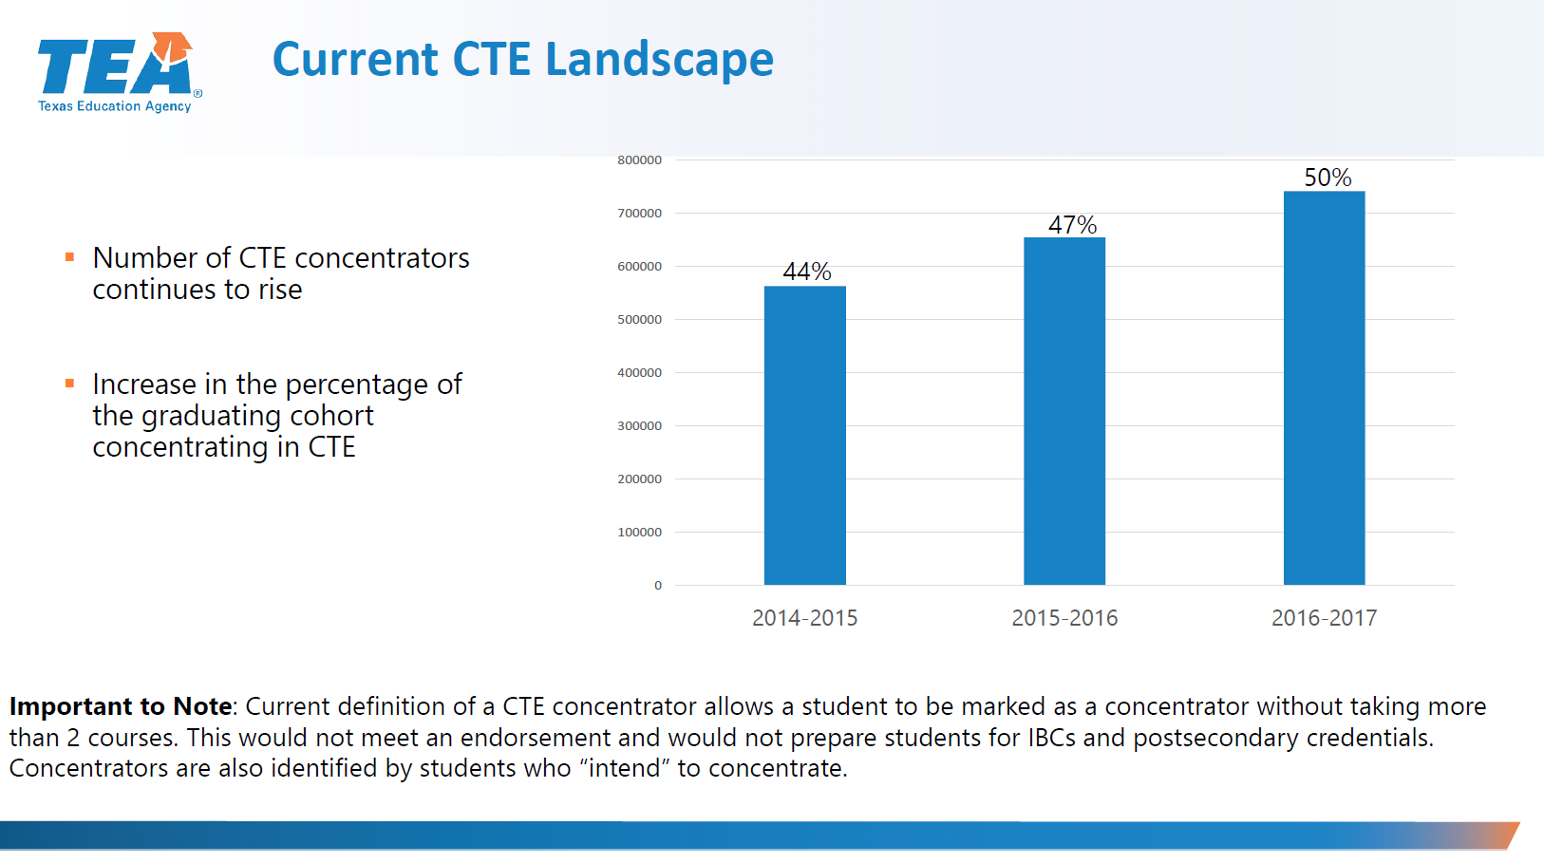

Slide 31
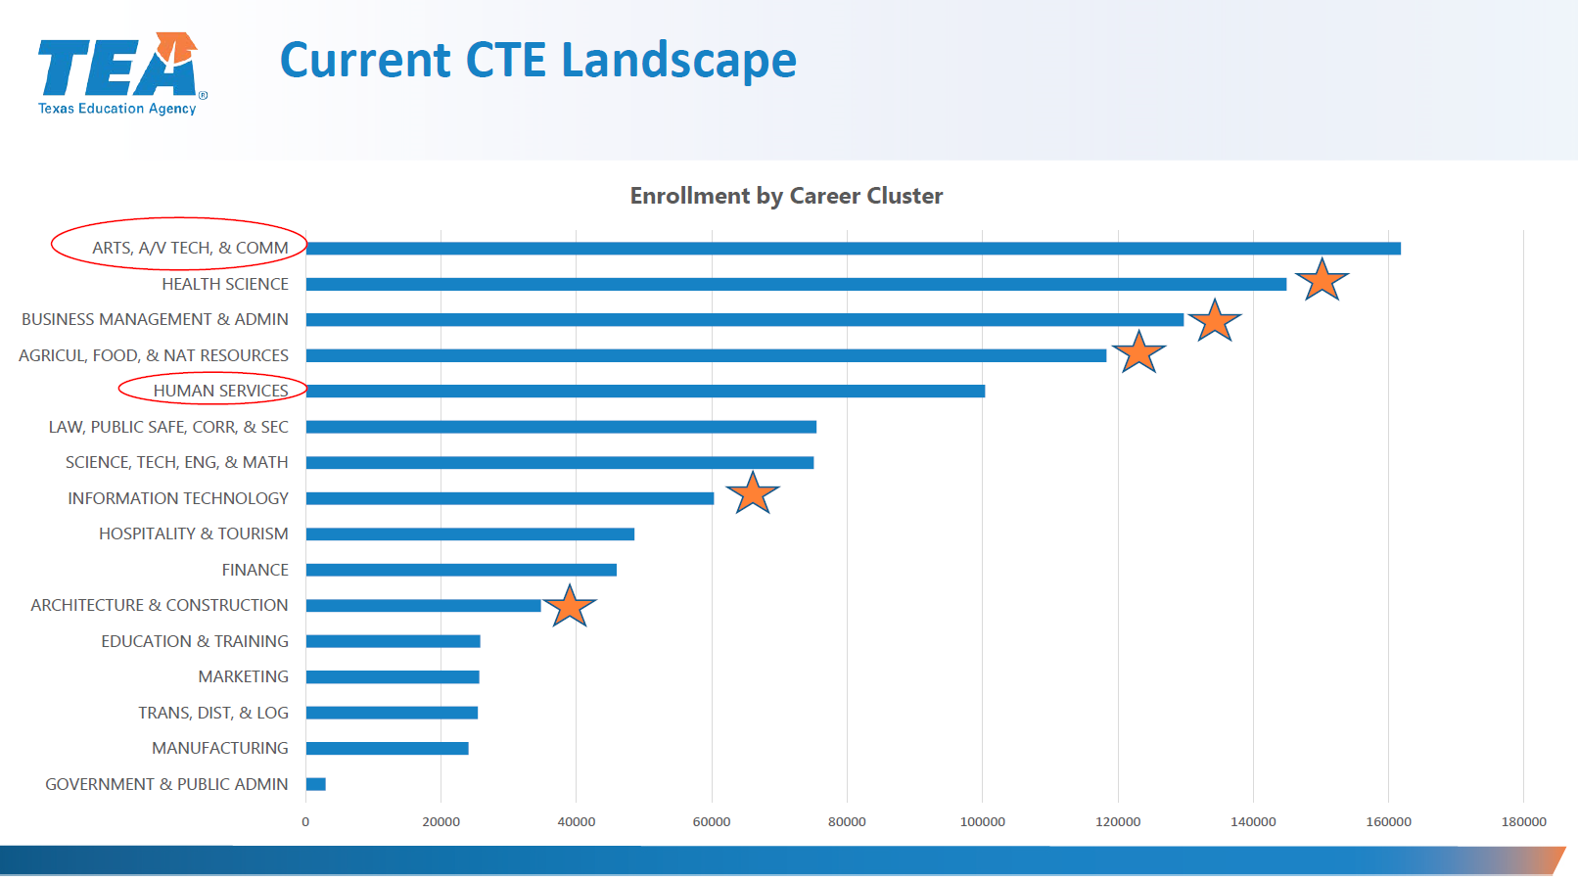

Slide 32

WHERE WE’D LIKE TO GO NEXT:
A deeper focus on central Texas, specifically Austin school districts.
Hone in on the specific career clusters.
A look at which districts are the top performers when it comes to CTE course offerings.
Utilize an API to see the effect certain demographics and regions have on course offerings, specifically schools that outperform their peers.
E

